Slide 1
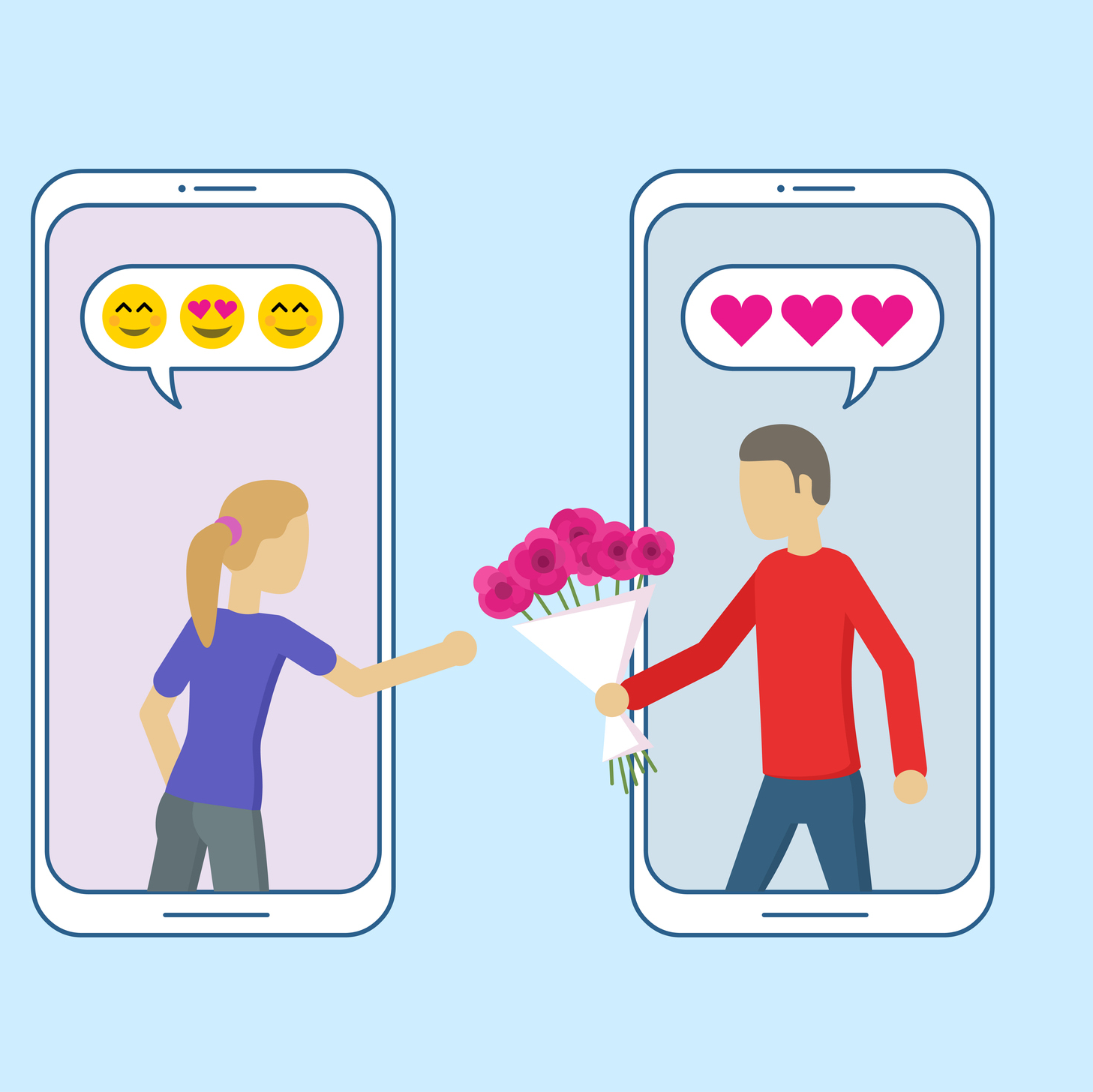
Prof Sam Chan
COMM3131 Online Dating and Hookup Culture
Meeting 1: Introduction

Slide 2
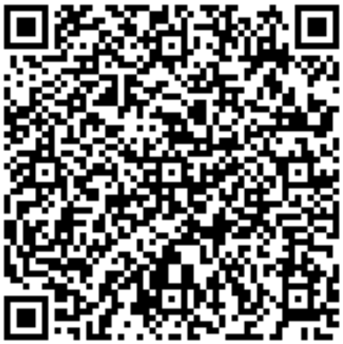
Today
Course content
Course policies
Two traditions of dating app studies
Swiped: Hooking Up in the Digital Age (HBO, 1 hr 28 mins)
Course Outline

Slide 3
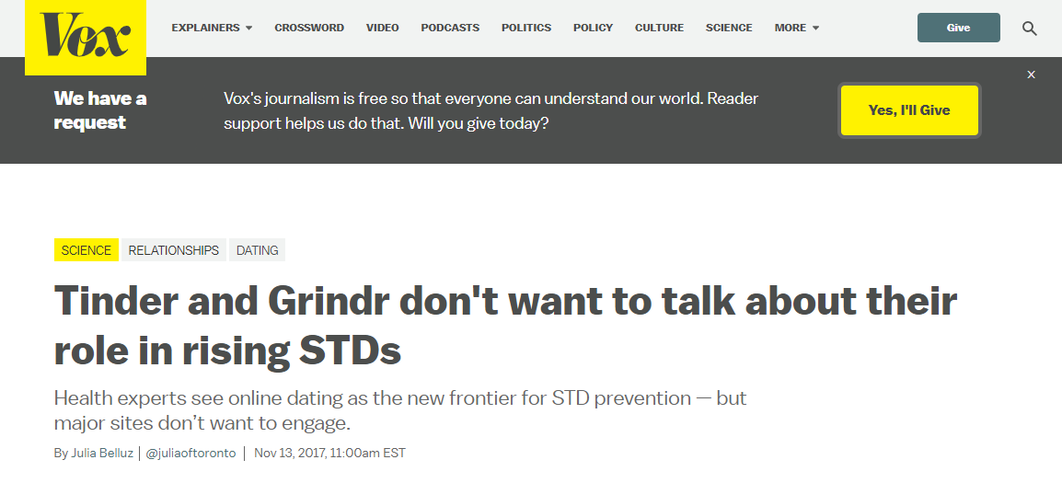

Slide 4
Themes covered
Online Fundamental
Meeting 2 | Getting it on line: How special is computer-mediated communication?
Interpersonal communication processes
Meeting 3 | “Still up?” Communicating about yourself and your desire
Meeting 4 | “What are you looking for, really?” Managing uncertainty online
Psychology of app design
Meeting 6 | Swiping versus screening: Design of dating apps
Cultural politics of dating apps
Meeting 7 | Can dating apps be a feminist tool?
Meeting 9 | No Asians, no femmes: Discrimination in online dating
Meeting 10 | Do we still need apps? On queer world-building
Integration
Meeting 12 | There’s always a darker side
Meeting 13 | Toward a new intimacy?
Course Outline

Slide 5
Learning outcomes
1. Understand the essential elements of relationship development in a digital context;
2. Articulate and explain various theories and concepts related to dating app designs;
3. Identify the opportunities and challenges that dating and hookup apps present to different groups of users; and
4. Take up a responsible mindset when using online dating platforms.
Course Outline

Slide 6
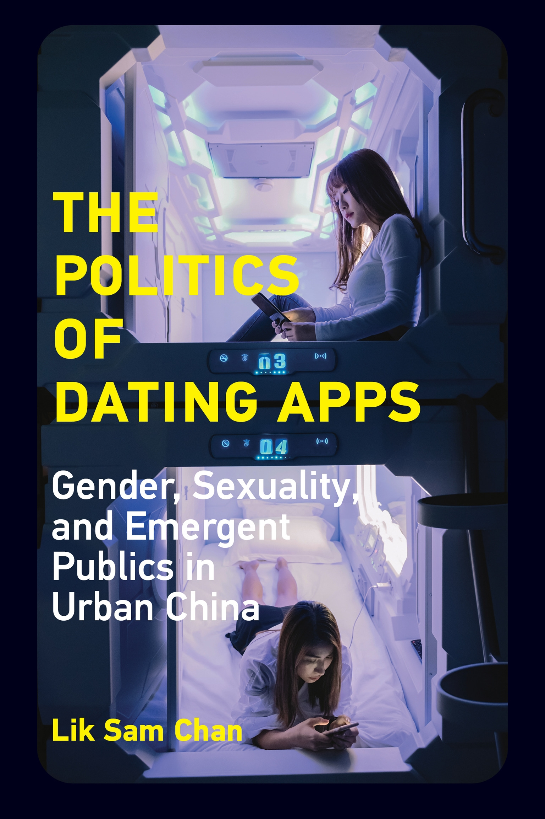
About me – Prof Sam Chan
Adjunct Associate Professor, School of Journalism and Communication, The Chinese University of Hong Kong
Lecturer in Digital Cultures, Discipline of Media and Communications, University of Sydney
PhD in Communication + Graduate Certificate in Gender Studies, University of Southern California
20 peer review articles in dating app cultures and 1 book (another book under contract)
Notes:
Link to the book: https://direct.mit.edu/books/book/5048/The-Politics-of-Dating-AppsGender-Sexuality-and

Slide 7
Teaching Assistant
Tomi Ng
toming@cuhk.edu.hk

Slide 8
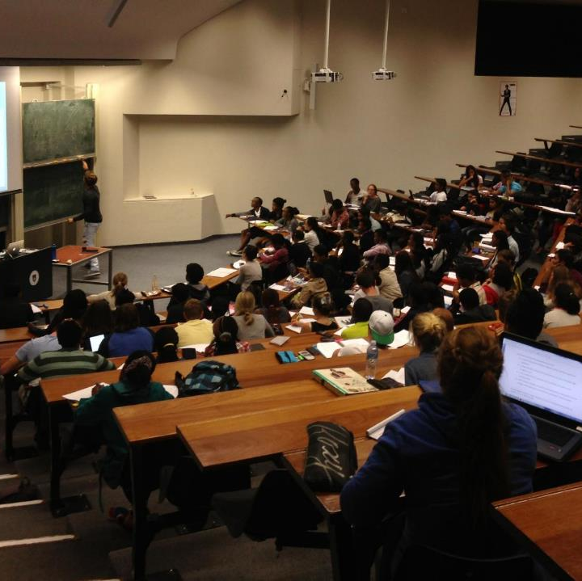
Style of meetings
2 hours 45 minutes per meeting (with breaks)
A mix of lectures, in-class discussions, and workshops (3!)
During lectures, feel free to interrupt if you have any doubts or disagreements
In-class discussions are both planned and ad hoc, contributing to your participation points
Workshops (Meetings 5, 8, 11) are pre-designed activities for engagement and application

Slide 9
Safe space ☺
I welcome critical and provocative thoughts with respectful tone

Slide 10
Assessments
Pre-class questions (individual) 15 points
Workshops (group + individual) 60 points
App pitch (individual) 25 points

Slide 11
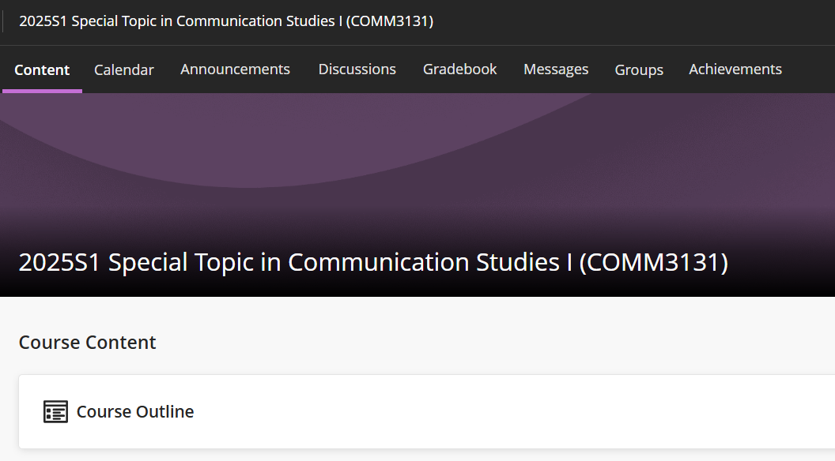
Pre-class questions (3 points × 5)
Pick any five classes, post a question regarding the required reading (marked with *) 9 pm the day before our class.
How to get full points? Your questions aim at generating in-class discussion. A great question is one that relates the readings to your observation, everyday life, or experiences (or your friend’s experiences). Definitional questions are seldom inspiring.
I do not accept late submission. Submit via Blackboard’s Discussions.

Slide 12
Workshops (20 points × 3)
Three workshops are as follows:
  Week 5 | Workshop I: “Hi, I am your relationship therapist.”
  Week 8 | Workshop II: Best app of the world
  Week 11 | Workshop III: Debate on a surprise topic
  Your grade comes from workshop output (15 points) and your participation in discussion regarding other groups’ outputs (5 points)
  How to get full points? Show exceptional understanding and application of concepts and demonstrate originality in your output their work. When it comes to participation, demonstrate exceptional engagement by contributing thoughtfully.
  No advanced preparation is expected apart from keeping up with daily reading.
  Unless for urgent or medical reasons, I do not provide make-up opportunities.

Slide 13
App pitch (25 points)
Design a new app for dating/hookups for one of the following groups:
  Women above 40 years old
  Transgender/gender-non-binary individuals
  Ethnic minorities (any one group) living in Hong Kong/your home country
Your task:
  Studying the experiences and challenges of a pre-identified group of dating app users through secondary or primary research.
  Evaluating existing apps that serve the same group of users.
  Suggesting a theoretically driven design of the app (only very basic drawings are expected).
  Word count of the proposal should be within 1,100 words (excluding references)
  Due: 11:59 pm on July 27 (Monday) via Blackboard (every day of late submission will result in a deduction of 5 points; anything submitted after 11:59 pm on July 31 will receive 0 points)

Slide 14

Attendance (Academic Policies)
You are expected to attend all scheduled classes during the International Summer School (ISS) programme.
If you are absent for three consecutive classes or more will be automatically withdrawn from the programme and no refund will be granted.

Slide 15

Academic honesty
Zero tolerance for any academic dishonesty
Details can be found at http://www.cuhk.edu.hk/policy/academichonesty/

Slide 16

Policy on the Use of Artificial Intelligence (AI) Tools
Approach 2: Some AI tool use in some scenarios
You can use AI tools for proofreading/language fluency (e.g., Grammarly) for your App Pitch without acknowledgement. I reserve the right to see your unpolished assignments.
Any use of generative-AI tools beyond this scope and in other assessments are not permitted.

Slide 17
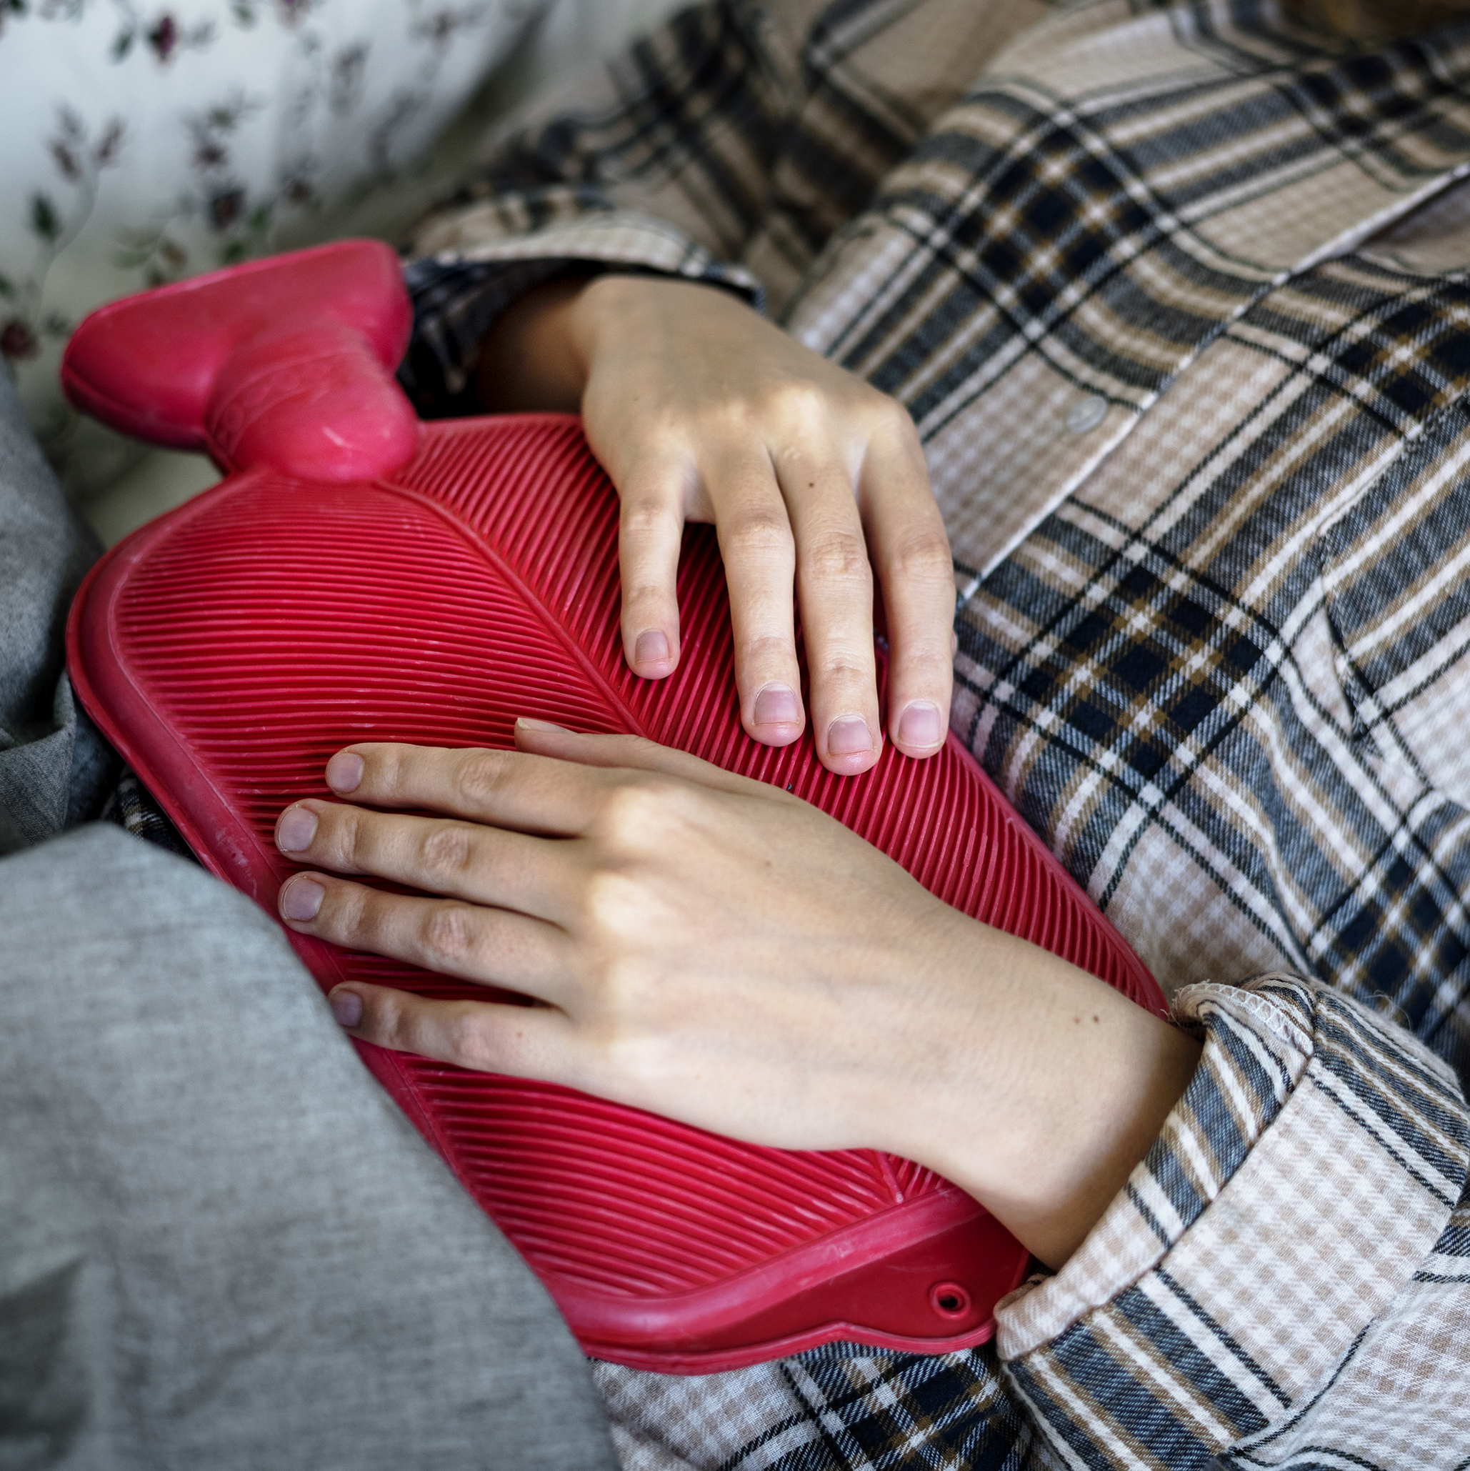
Sick leave
Make-up opportunities for pre-class questions are not available
Should you need to miss a workshop due to health concerns, you may request a make-up assignment
This request must be accompanied by a valid medical certificate and submitted within three days of the original workshop date

Slide 18
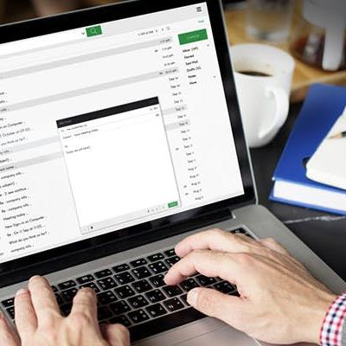
Communication via emails
Check your CUHK email once a day
When you write to me, please use [COMM3131] as the subject line—I will miss your email if you don’t do so

Slide 19
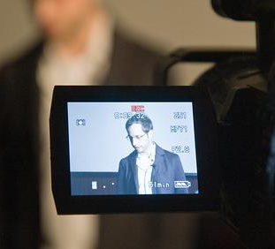
Video/audio recording
No recording unless permission from the entire class.

Slide 20

Reference letter
I accept invitations from students who have completed at least one course with me
Three weeks in advance

Slide 21
Two traditions of dating app research

Slide 22
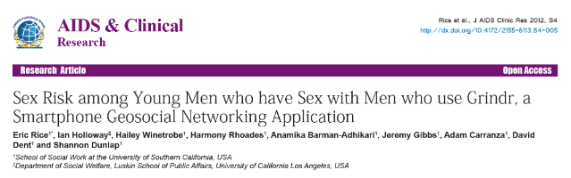
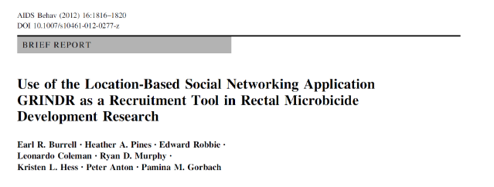
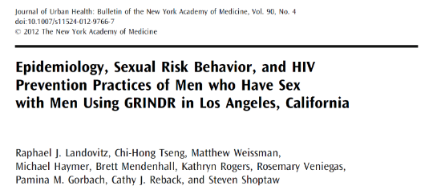

Slide 23
Social scientific tradition
Who are users?
What do individuals use dating apps for?
How do individuals represent themselves on dating apps?
How do individuals develop relationships on dating apps?
What are the risks to individuals with dating app use?
Notes:
Chan, L. S. (2021). Politics of dating apps: Gender, sexuality, and emergent publics in urban China. MIT Press. pp. 1–10 of “Introduction”

Slide 24
Critical tradition
Power
Second-wave feminism: “The personal is political”
Society is structured by multiple axes of domination
Michel Foucault: “relations of power are not in a position of exteriority with respect to other types of relationships (economic processes, knowledge relationships, sexual relations), but are immanent in the latter” (Foucault, 1979, The History of Sexuality, p. 94)
Notes:
Chan, L. S. (2021). Politics of dating apps: Gender, sexuality, and emergent publics in urban China. MIT Press. pp. 1–10 of “Introduction”

Slide 25
Two traditions of dating app research
Social scientific tradition
Critical tradition
Individual
Focuses on behaviors
Society
Focuses on power relations (of course backed up by behaviors)
Notes:
Chan, L. S. (2021). Politics of dating apps: Gender, sexuality, and emergent publics in urban China. MIT Press. pp. 1–10 of “Introduction”

Slide 26
What issues you want to explore in this course?

Slide 27
Agenda for Meeting 2
Get to know you more and sign the acknowledge (last page of the course outline)
Lecture: Getting it on online: How special is CMC?
Basic statistical understandings (optional)

